Slide 1
VE281 Data Structures and Algorithms
Introduction

Slide 2
Outline
Course logistics
Introduction

Slide 3
Time and Location
Time: Wednesday 4:00-5:40 pm, Friday 4:00-5:40 pm, and Monday 4:00-5:40 pm (even weeks)
Location: F115 (Monday and Friday), D106 (Wednesday)

Slide 4
Instructor
Hongyi Xin
2007 JI alumni (I know you guys pretty well)
CMU CS PhD
Email: hongyi.xin@sjtu.edu.cn
Phone: 34206765-4361
Office: Room 436, Long Bin (JI) Building
Office hour
Tuesday 10:00 – 11:00 am
Thursday 10:00 – 11:00 am
Or by appointment (schedule by email, 2 days in advance)

Slide 5

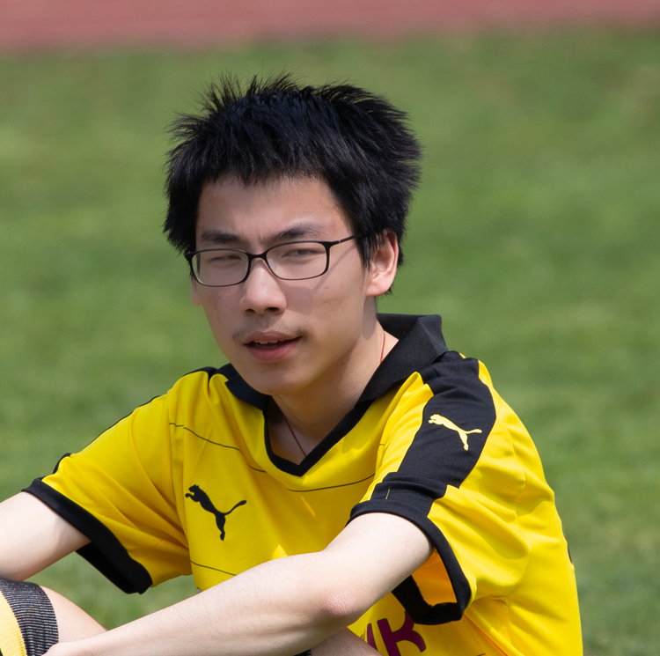
Teaching Assistants
Lin, Chenchao
Email: vinlin@sjtu.edu.cn
Wang, Yichao
Email: wangyichao1304@sjtu.edu.cn

Slide 6

Teaching Assistants
Gu, Zhenhao
Email: guzhenhao1@sjtu.edu.cn
Contact them through Feishu!

Slide 7
Textbooks for Reference (Not Required)
“Data Structures and Algorithm Analysis,” by Clifford Shaffer. Online available: http://people.cs.vt.edu/~shaffer/Book/C++3e20120605.pdf
“Algorithms,” by S. Dasgupta, C. Papadimitriou, and U. Vazirani.
“Introduction to Algorithms, 3rd edition,” by Thomas Cormen et al., MIT Press, 2009.
“Data Structures and Algorithms with Object-Oriented Design Patterns in C++,” by Bruno Preiss.

Slide 8
Grading
Composition
Participation: 5%;
It is your job to get me know about you.
Discuss on piazza; ask questions during breaks; come to office hours.
6 written assignments: 20%
5 programming assignments: 30%
Midterm exam (written): 20%
Final exam (written): 25%
We will curve the final grades, if necessary.
Questions about the grading?
Must be mentioned to the instructor or the TAs within one week after receiving the item.
Notes:
We will adjust the curve up or down if the class as a whole does better or worse than past instances. In particular, if everyone does exceptionally well, then everyone will get an exceptionally good grade.

Slide 9
Programming Assignments
We require you to develop your programs using C++ on Linux operating systems with the compiler g++.
C++11 standard is allowed.
Compile with the option –std=c++11
You will be assigned a Linux virtual development environment, you MUST finish your assignment within the designated VM environment
Do experiments on algorithms, e.g., sorting algorithm

Slide 10
Written Assignments
2 formats:
In class quiz
Fewer questions.
Mostly simulating processes of algorithms.
1 hour period during recitation classes (TBA).
Must arrive on time (late for no more than 10 min).
Take home assignment
3x more questions.
Include writing proofs.
Must finish individually (I take OC very seriously).

Slide 11
Assignment Deadline
Each written assignment must be turned in before class on its due date.
Each programming assignment (PA) must be turned in by 11:59 pm on the due date to be accepted for full credit.
However, we still allow you to submit your PA within 3 days after the due date, but there is a late penalty.
No PA will be accepted if it is more than 3 days late!
Hours Late | Scaling Factor
(0, 24] | 80 %
(24, 48] | 60 %
(48, 72] | 40 %

Slide 12
Assignment Deadline
In very occasional cases, we accept deadline extension request.
Contact ME, not TAs!
Tell me early! The earlier you let me know the more likely I will accommodate to your case!
ONLY be granted for documented medical/personal emergencies or Academic reasons that could not have been anticipated
NOT granted for reasons such as accidental erasure/loss of files and outside conflicting commitments
If you experience any issues with your VM environment, email TAs right away with me CC’ed

Slide 13
Some Suggestions
Come to the class
Start doing the homework early!
Don’t wait until the last minute. Numerous lessons before
Back up your code frequently in case your accidentally deletes your code files.
In real world, if you accidentally delete company’s code, you’ll get fired! Build good habits!

Slide 14
Exams
Written exams.
Some short questions.
Some algorithm design problems.
Closed book and closed notes.
No electronic devices are allowed.
These include laptops and cell phones.

Slide 15
Collaboration and Cheating
You may discuss in oral with your classmates.
But you must do all the assignments yourself.
Some behaviors that are considered as cheating:
Reading another student’s answer/code, including keeping a copy of another student’s answer/code.
Copying another student’s answer/code, in whole or in part.
Having someone else write part of your assignment.
Using test cases of another student.
Testing your code with another one’s account. (Testing chances are limited.)
Keep your code safe! (You are also responsible if your code is leaked)
“Another student” includes a student in the current semester or in the previous semester.
Notes:
You are supposed to do it yourself. Why do you need a copy of another’s work?

Slide 16
Collaboration and Cheating
The previous lists of behaviors are deliberate cheating, but some unintentional actions could make you look like cheating. For example,
Using other people’s code to test the autograder
You should be extremely careful!
Do not share photos of your code!
Notes:
Yes, they do happen previously!

Slide 17
Collaboration and Cheating
In summary, you should be responsible for all answers/codes you submit. If you submit a copy of another student’s work (or overwrite another student’s work), it is considered cheating, no matter of the reason!

Slide 18
Collaboration and Cheating
Any suspect of cheating will be reported to the Honor Council at JI.
For programming assignments, we will run an automated test to check for unusually similar programs. Those that are highly similar - in whole or in part - will be reported to the Honor Council at JI.
Penalty of honor code violation
Reduction of the grade for this assignment to 0, plus
Reduction of the final grade for the course by one grade point, e.g., B+ → C+, for both students involved

Slide 19
Canvas
Log into Canvas: https://umjicanvas.com
Check the class webpage on the Canvas regularly for
Announcements
Slides
Assignments
Course slides will be uploaded onto Canvas before each lecture.

Slide 20
Getting Help
If you have any technical questions, come to see TAs and instructor during the office hour!
Answering technical questions through email is inefficient and I will only answer them during office hours.
Post questions on Piazza.
Answer other student’s questions (counts toward participation)

Slide 21
Get the Most out of a Lecture
Information breakdown:
Verbal communication is a linear process.
You cannot understand the rest of the lecture if your missed a key concept.
Ask questions!
Lecture format:
4 mini-classes and 3 short breaks in between.
Ask questions during short breaks (ask out loud and in turn).

Slide 22
Prerequisite
Ve280 Programming and Elementary Data Structures
Compiling and debugging on Linux operating systems
C++ programming, including pointers, arrays, structs, etc.
Recursion
I/O streams, including file I/O
Classes
Dynamical memory management
Template
Linked list, stack, and queue

Slide 23
Prerequisite
Ve203 Discrete Mathematics
Computational complexity analysis
Some basic sorting algorithm, e.g., bubble sort, insertion sort, merge sort
Divide-and-conquer algorithm, master theorem
Graph, graph representation, depth first search, Dijkstra’s algorithm (shortest path)
Some important concepts will be reviewed

Slide 24
References and Copyright
Slides used (modified when necessary)
Weikang Qian, JI, SJTU
Sugih Jamin, University of Michigan
Sartaj Sahni, University of Florida
Bert Huang, Columbia University
Tim Roughgarden, Stanford University
Clifford Shaffer, Virginia Tech

Slide 25
Outline
Course logistics
Introduction

Slide 26
Data Structures and Algorithms
Data structure is a particular way of organizing data in a computer so that it can be used efficiently.
Example: linked list
We can store a set of records as a linked list
or as a tree (to be talked later).
first
Notes:
All programs manipulate data. So, all programs represent data in some way.
We may store record as an unsorted array / an array / linked list. But not only just store it, we want to do the operations efficiently.
The record stored by linked list is not efficient, for example

Slide 27
Logical versus Physical Form
A data structure have both a logical and a physical form.
Logical form: definition of the data structure at an abstraction level.
Physical form: implementation of the data structure.
Notes:
Next slide will show example

Slide 28
Data Structure Example: Linked List
class IntList {
node *first;
public:
...
};
Logical Form
first
Physical Form
struct node {
node *next;
int value;
};
next:
value:
next:
value:
next:
value:
4
2
3

Slide 29
Data Structures and Algorithms
Data manipulation requires an algorithm – a sequence of steps that solve a specific task.
Data structures + Algorithms = Programs
The study of data structures and algorithms is fundamental to Computer Science.
Database related to balanced binary search tree.
Computer networks related to shortest path algorithm.
...

Slide 30
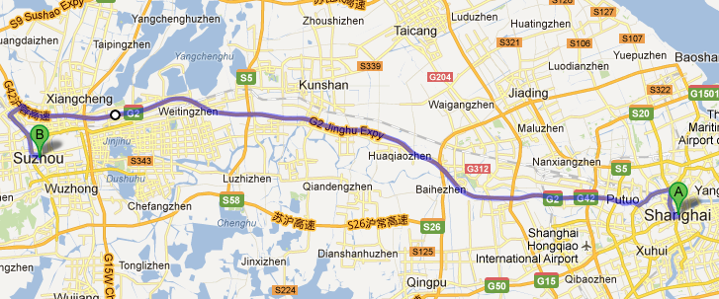
Real World Problem: Navigation
Finding the shortest route from Shanghai to Suzhou

Slide 31
Real World Problem: Navigation
What information do we need?
Streets.
Intersections of streets. (We assume that our departure place and destination are at certain intersections.)
How do we store the information in computer?
Graph: consisting of “nodes” and “edges”.
Each edge has a weight to denote the distance between two nodes.
DS:
Adjacency list
Adjacency matrix
5
3
2
1
Notes:
Streets as edges and intersections as nodes

Slide 32
Real World Problem: Navigation
The algorithm: finding the shortest path from a source node (A) to a sink node (B).
Algorithms adapt to data structures
5
A
3
2
1
B

Slide 33
Challenges: Efficiency
For a small number of nodes, we can enumerate all the possible paths.
Path A → C → B: 8;
Path A → D → C → B: 6;
The minimum is 6.
5
A
C
3
2
1
D
B

Slide 34
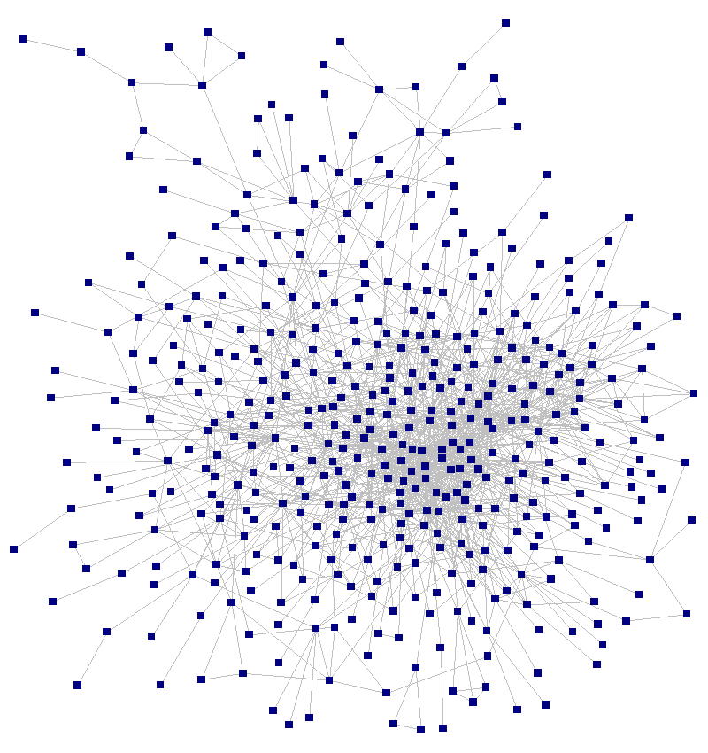
Challenges: Efficiency
However, in real world, the graph is much more complicated.
It is impossible to enumerate all the possible paths!
How can we solve the problem?
Dijkstra’s algorithm

Slide 35
More about Efficiency
Choice of data structures or algorithms can make the difference between a program running in a few seconds or many days.
Example: Number of comparisons for linear search and binary search (Worst Case)
Input Size | Linear | Binary | Ratio (L/B)
64 | 64 | 6 | 10.7
128 | 128 | 7 | 18.3
256 | 256 | 8 | 32
512 | 512 | 9 | 56.9
1024 | 1024 | 10 | 102.4

Slide 36
More about Efficiency
A solution is said to be efficient if it solves the problem within its resource constraints.
Space, i.e. memory consumption.
Time.
The cost of a solution is the amount of resources that the solution consumes.
We value efficiency of the data structures and algorithms!
We will learn how to analyze their efficiency.
✓
Our major concern

Slide 37
Course Objectives
Learn the tool:
Common data structures and algorithms.
And their efficiency.
Apply the tool
Solve a problem using existing data structures and algorithms.
Choose the right tool: some tools are better for certain tasks than other tools. Do performance analysis.

Slide 38
Topics
Asymptotic Algorithm Analysis
Data structures
Trees, including binary search tree, balanced binary search tree
Hash table
Heaps
Graphs
Algorithms
Sorting and searching
Graph-related algorithms, such as minimum spanning tree, topological sorting
Dynamic programming

Slide 39
Questions?

